Slide 1

HADOOP AND HIVE
Team: DR.B.R Ambedkar

Slide 2

BEIJING WINTER OLYMPIC 2022

Slide 3

Supermarket sales in Mynmar.

Slide 4
Hadoop
Medals and Supermarket sales

Slide 5
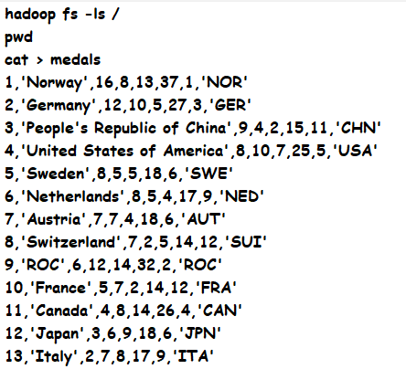
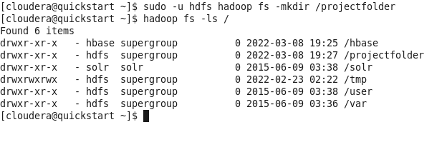
Medals:- Creating a project folder and viewing it. # sudo –u hdfs hadoop fs –mkdir /projectfolder # Hadoop fs –ls /

Slide 6
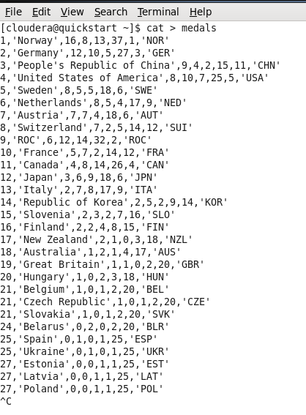
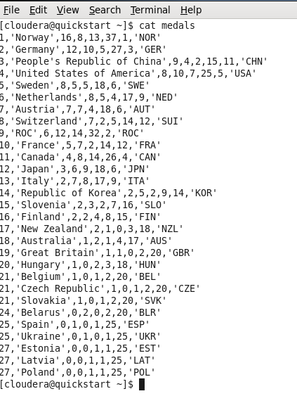
creating medals file and inserting data and viewing the data in the medals file. # cat > medals

Slide 7
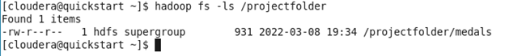
Inserting medals file into project folder and viewing the inserted file. # sudo –u hdfs Hadoop fs –put medals /projectfolder # Hadoop fs –ls /projectfolder

Slide 8
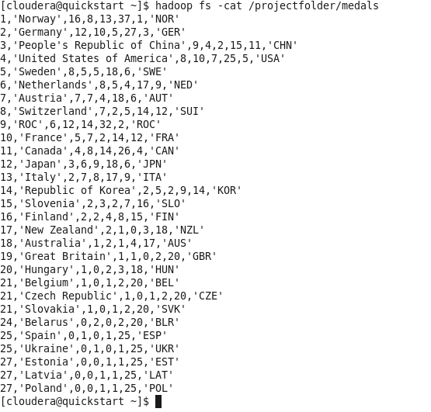
To see the content of the file medals. # Hadoop fs –cat /projectfolder/medals

Slide 9
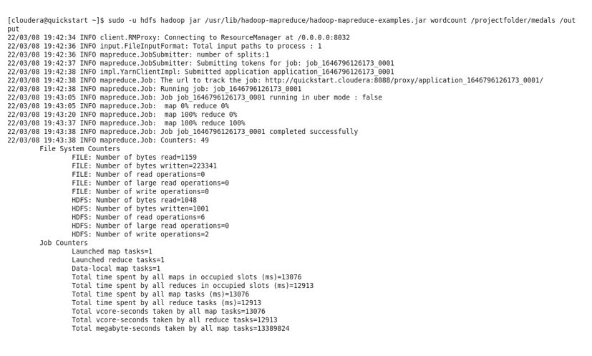
Map reduce of medals file. # sudo –u hdfs jar /use/lib/Hadoop-map reduce-jar wordcount /projectfolder/medals/output

Slide 10
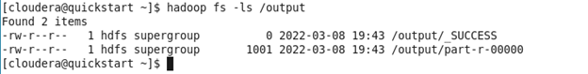
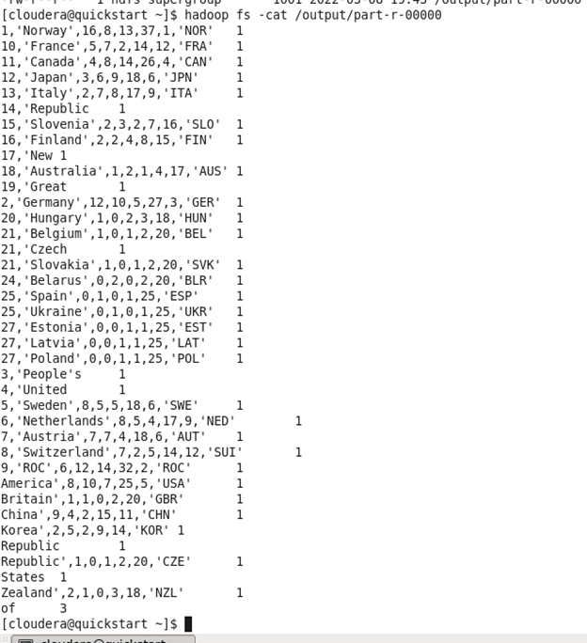
Viewing the output of map reduce and counting of word. # hadoop fs –ls /output # Hadoop fs –cat /output/part-r-00000

Slide 11
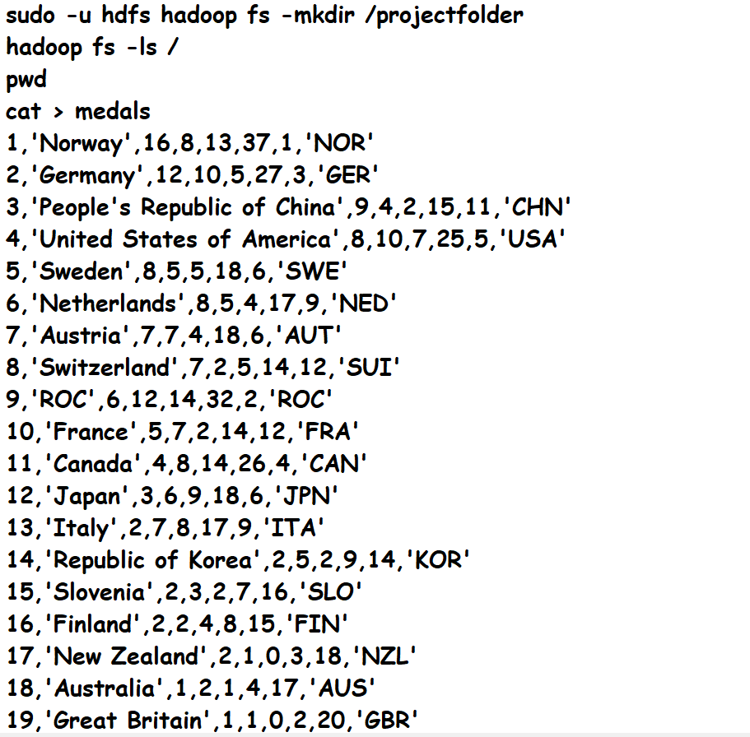
Commands used. # sudo –u hdfs hadoop fs –mkdir /projectfolder # hadoop fs –ls /

Slide 12
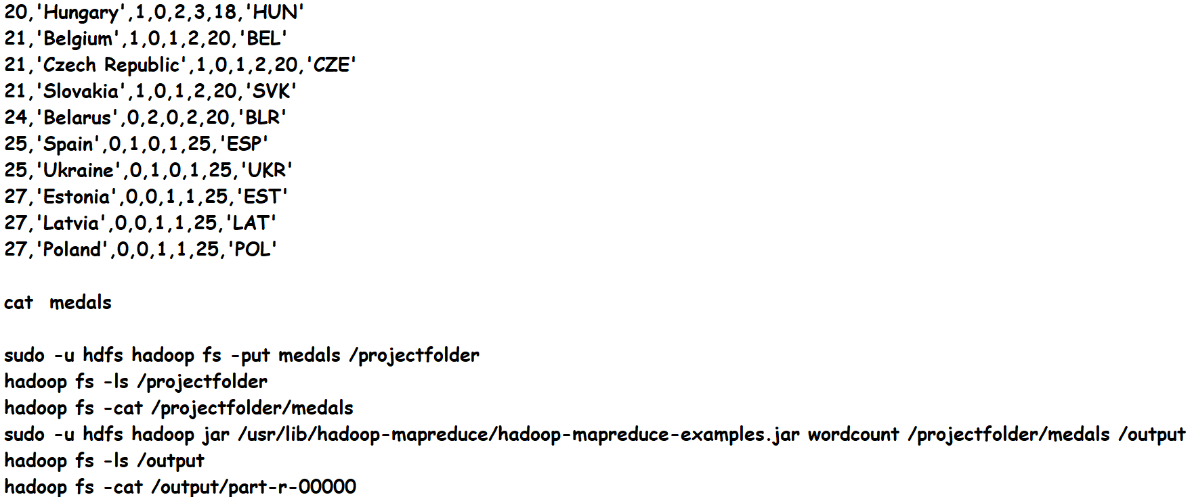

Slide 13
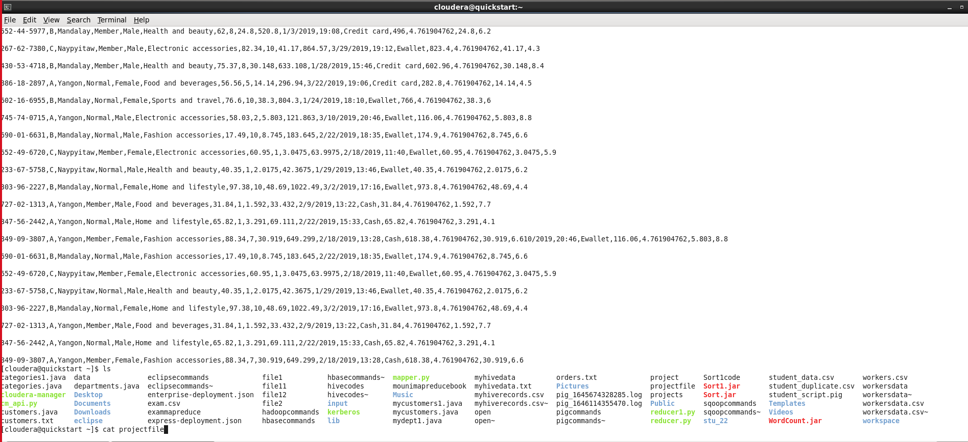
Supermarket sales:- Insertion of data and the viewing the folder.

Slide 14
Insertion of project file into project folder and viewing it. # sudo –u hdfs hadoop fs –put projectfile /projectfolder # hadoop fs –cat /projectfolder/projectfile

Slide 15
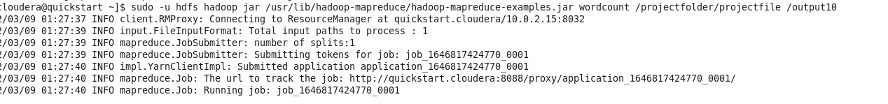
Map reduce of project file. # sudo –u hdfs hadoop jar /usr/lib/hadoop-map reduce/hadoop-mapreduce-examples.jar wordcount /projectfolder/projectfile /output10

Slide 16
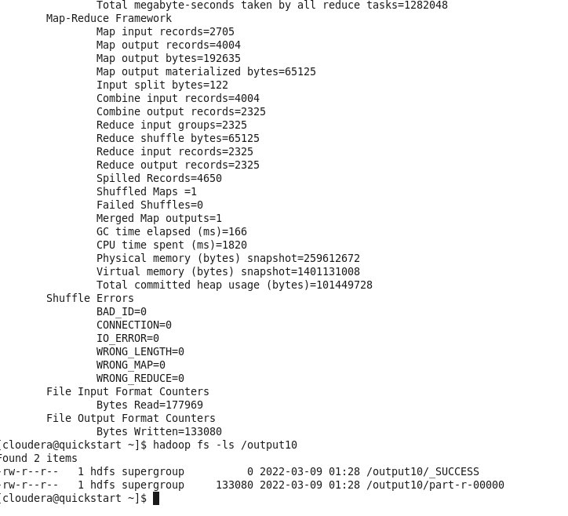
Viewing the output of map reduce. # hadoop fs -ls/output18

Slide 17
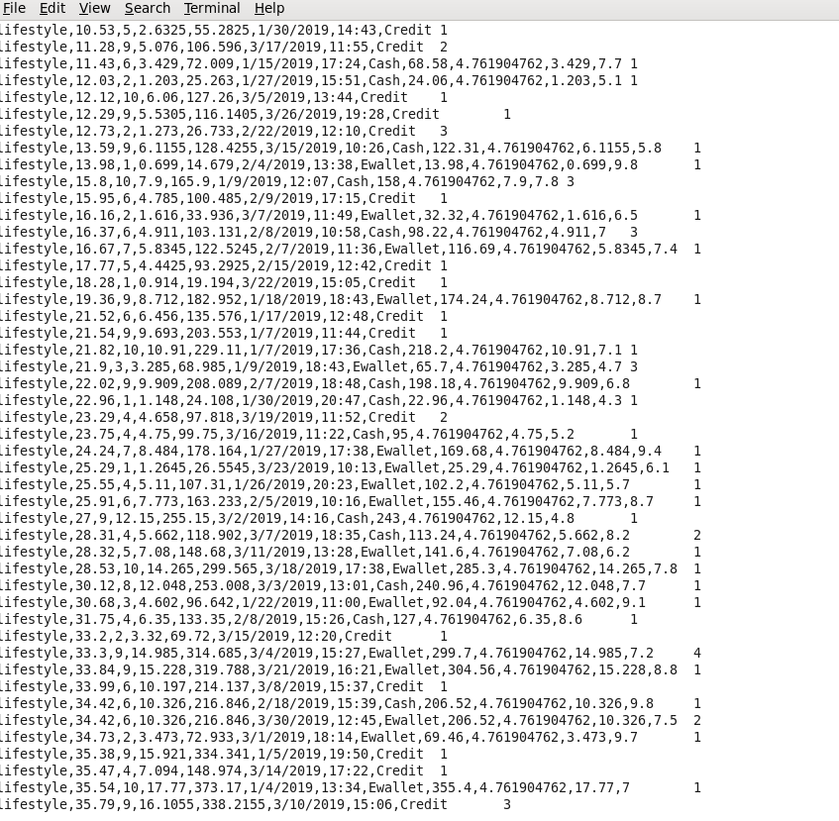
Viewing the contents of the project file. # hadoop fs -cat /output18/part-r-00000

Slide 18
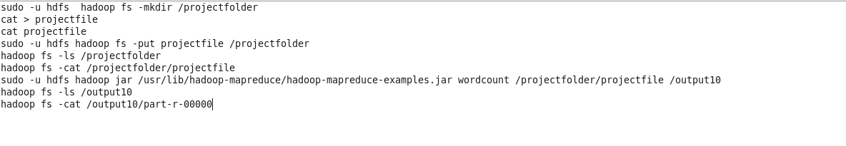
Commands used

Slide 19
Hive
Medals and Supermarket-sales

Slide 20
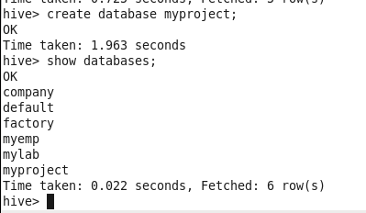
Medals:- Creating database . # create database myproject;

Slide 21
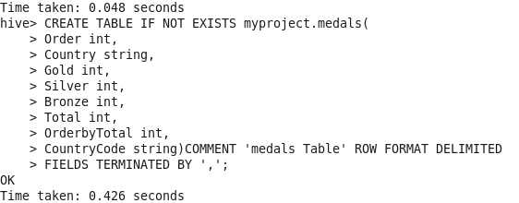
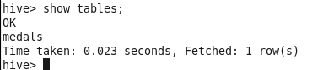
Creating and viewing the table. # create table if not exists myproject.medals(order int, country string…..)comment ‘medals table’ row format delimited fields terminated by ‘,’; # show tables;

Slide 22
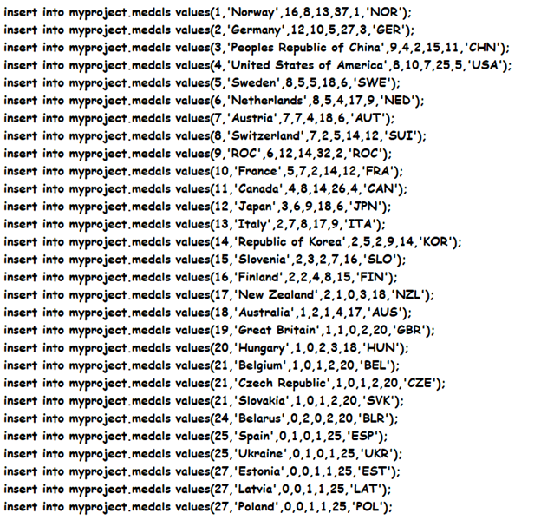
Insertion of data into medals table. # insert into myproject.medals values(1,’Norway’,16,8,13,37,1,’NOR’);

Slide 23
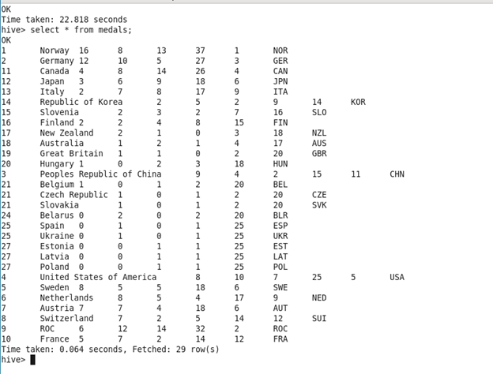
Viewing the data inserted into medals table. # select * from medals;

Slide 24
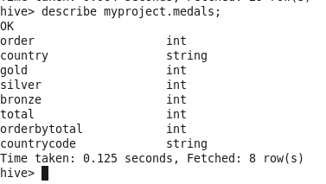
Describing table of medals. # describe myproject.medals;

Slide 25
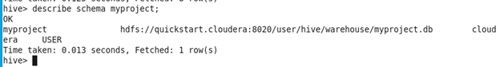
Describing schema of database myproject. # describe schema myproject;

Slide 26
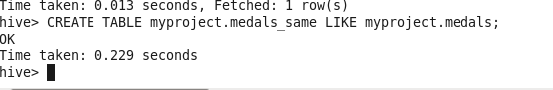
To clone the structure of the table. # CREATE TABLE myproject.medals_same LIKE myproject.medals;

Slide 27
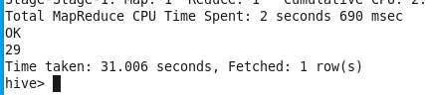
Counting number of rows in medals table. # Select count(*) from medals;

Slide 28
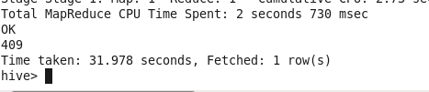
Counting sum of all medals. # Select sum(Orderby Total) from medals;

Slide 29
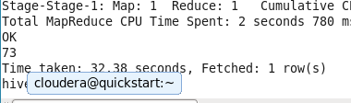
Viewing sum of distinct gold medals. # Select sum(distinct Gold) from medals;

Slide 30
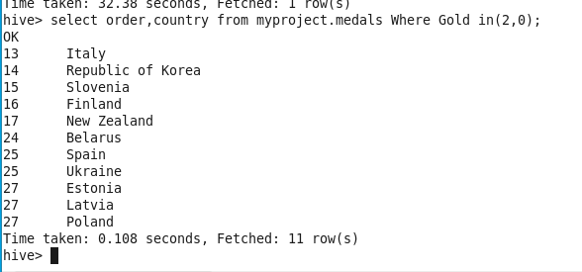
Viewing the countries who scored zero and two gold medals. # select order, country from myproject.medals Where Gold in(2,0);

Slide 31
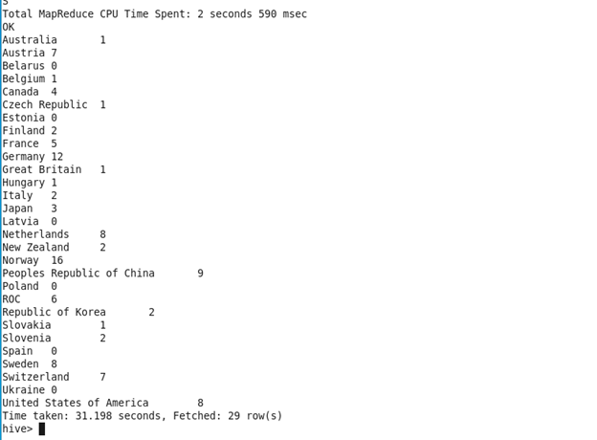
Sum of Gold medals won by each country. # select country, sum(gold) from medals group by country;

Slide 32
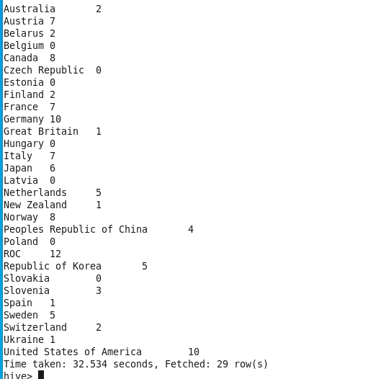
Sum of Silver medals won by each country. # select country, sum(Silver) from medals group by country;

Slide 33
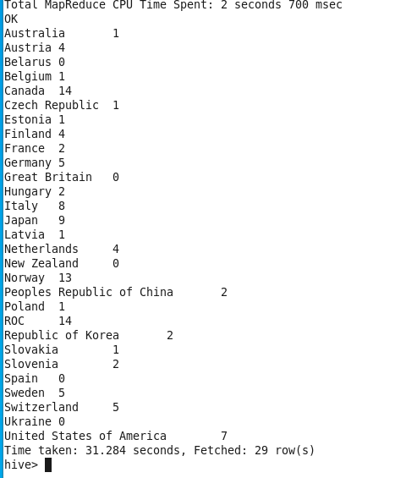
Sum of Bronze medals won by each country. # Select country, sum(Bronze) from medals group by country;

Slide 34
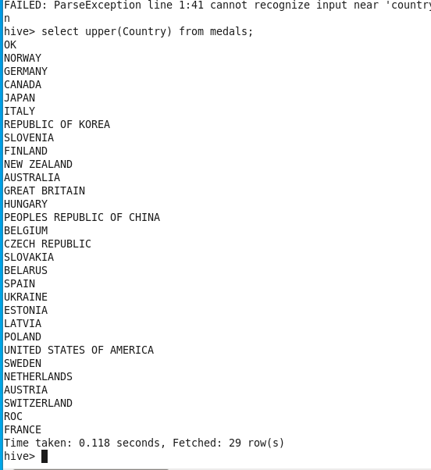
Capitalizing all letters in the country name. # Select upper(Country) from medals;

Slide 35
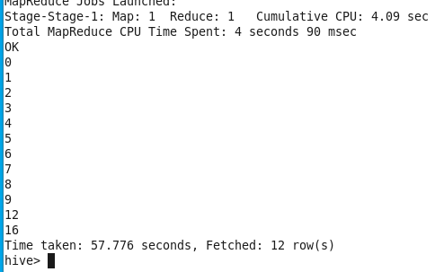
Viewing distinct gold medals # Select distinct(gold) from medals;

Slide 36
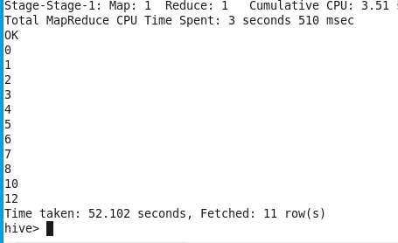
Viewing distinct silver medals # Select distinct(silver) from medals;

Slide 37
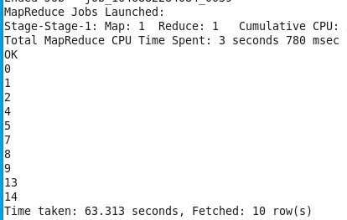
Viewing distinct bronze medals # Select distinct(bronze) from medals;

Slide 38
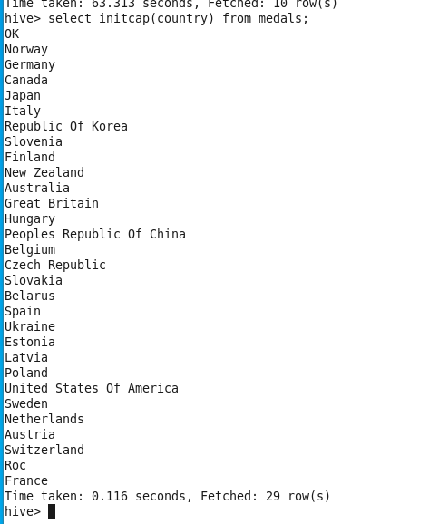
Capitalizing first letter of country # Select initcap(country) from medals;

Slide 39
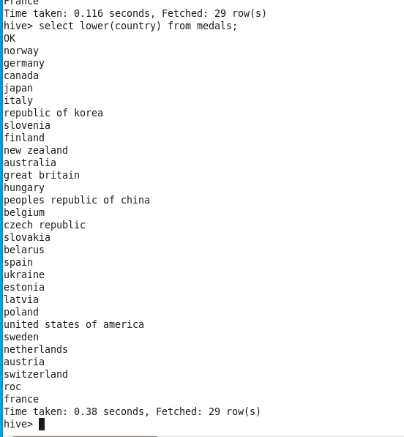
Showing the country name in lower case # Select lower(country) from medals;

Slide 40
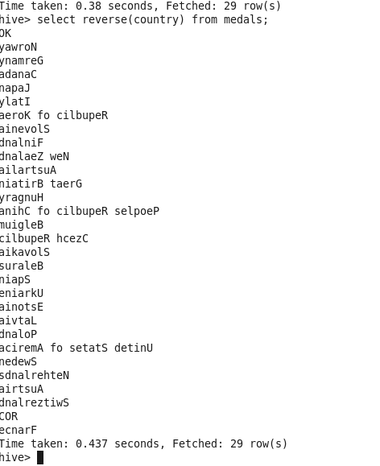
Reversing the spelling of country. # Select reverse(country) from medals;

Slide 41
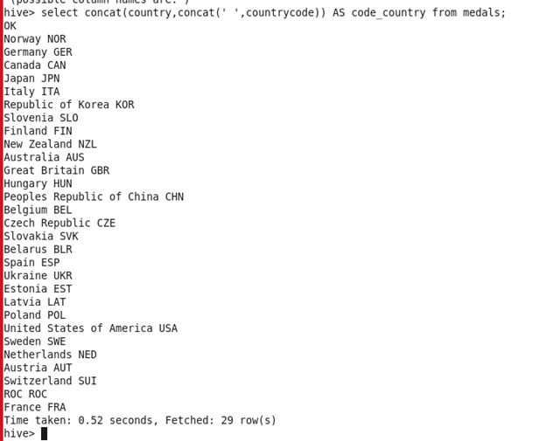
Concatenation of country and country code. # select concat(country, concat(' ',countrycode)) AS code_country from medals;

Slide 42
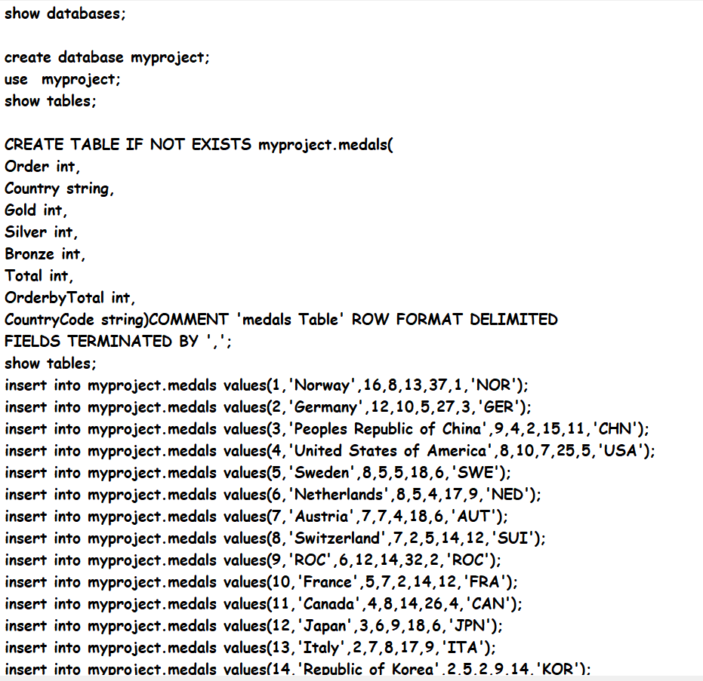
Commands used.

Slide 43
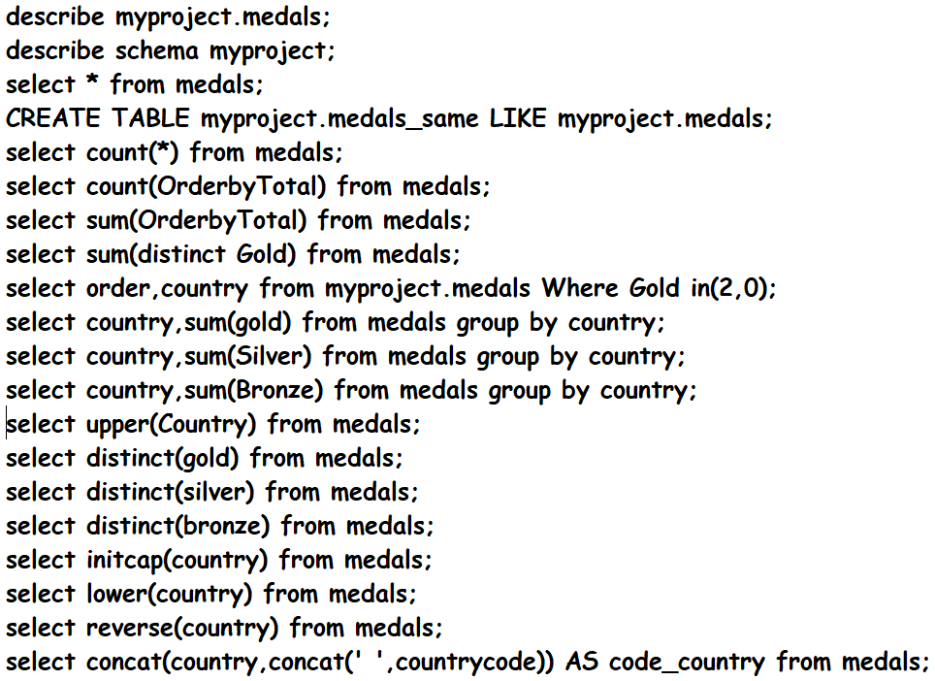
.

Slide 44
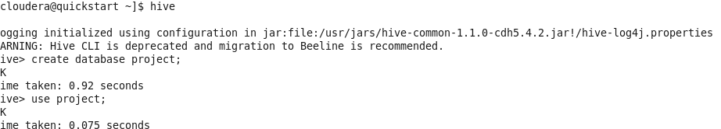
SUPERMARKET SALES:- #hive #create database project;

Slide 45
Creating table projects in database project: #create table if not exists project.projects(city string, quantity int,…..)row format delimited fields terminated by’,’

Slide 46
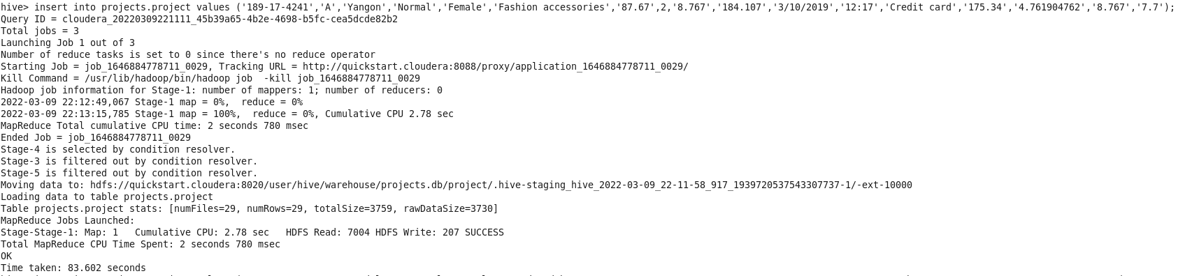
Inserting data: #insert into project.projects values(‘Yangon’,87,’female’………..);

Slide 47
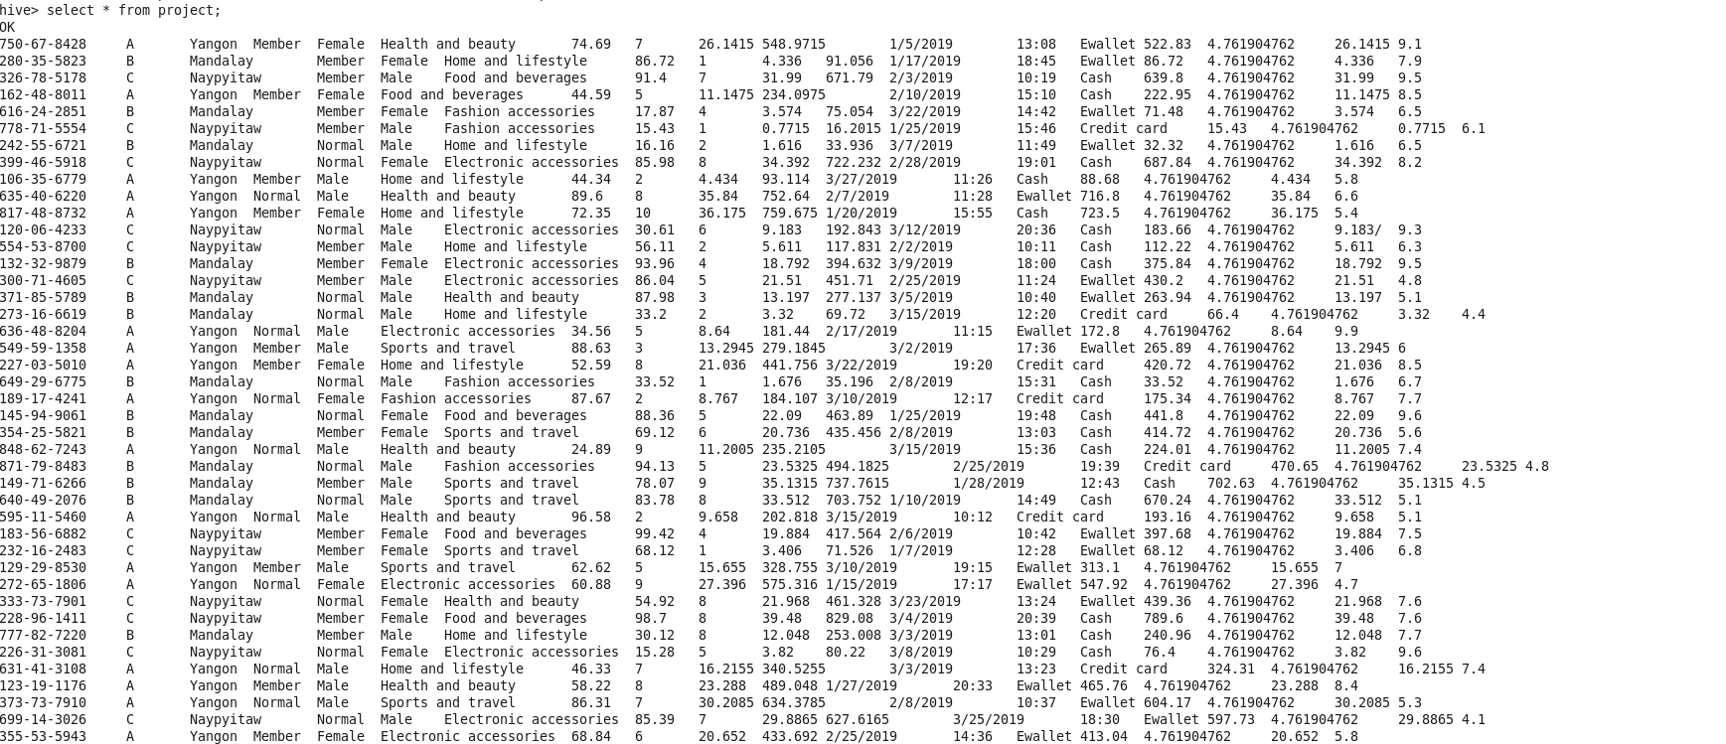
Viewing the inserted data: #select * from project;

Slide 48
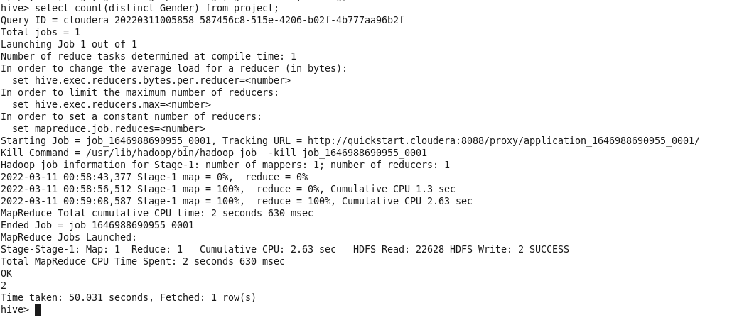
Counting distinct gender: #select count(distinct gender)from project;

Slide 49
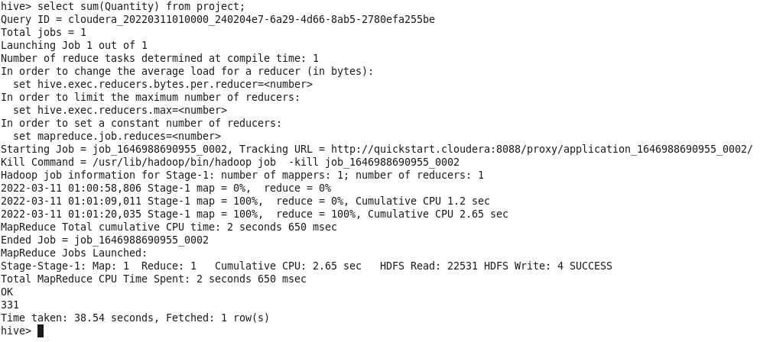
Finding sum of quantity: #select sum(quantity) from project;

Slide 50
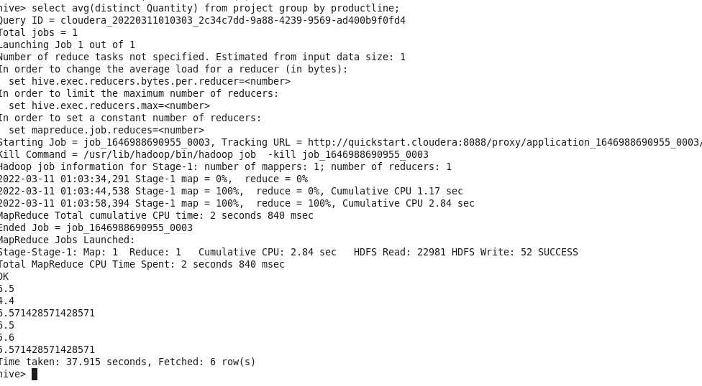
Finding average of distinct quantity of product lines: #select avg(distinct quantity) from project group by productline;

Slide 51
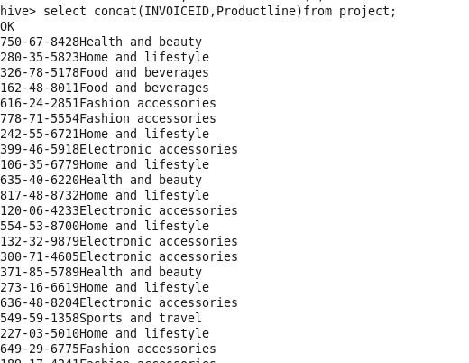
Concatination of two columns: #Select concat(invoice id, productline)from project;

Slide 52
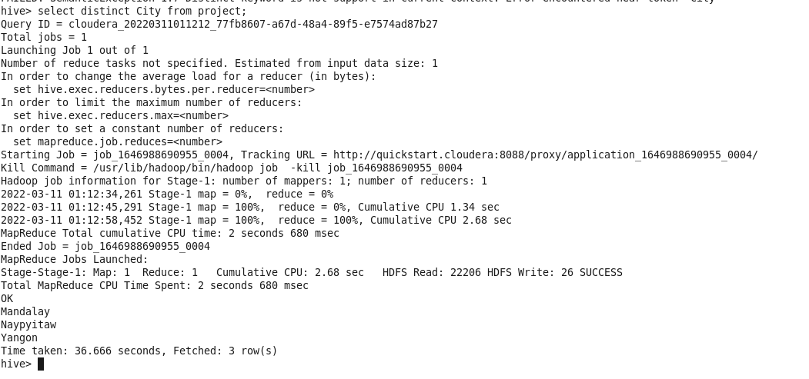
Finding distinct cities: #select distinct(city) from project;

Slide 53
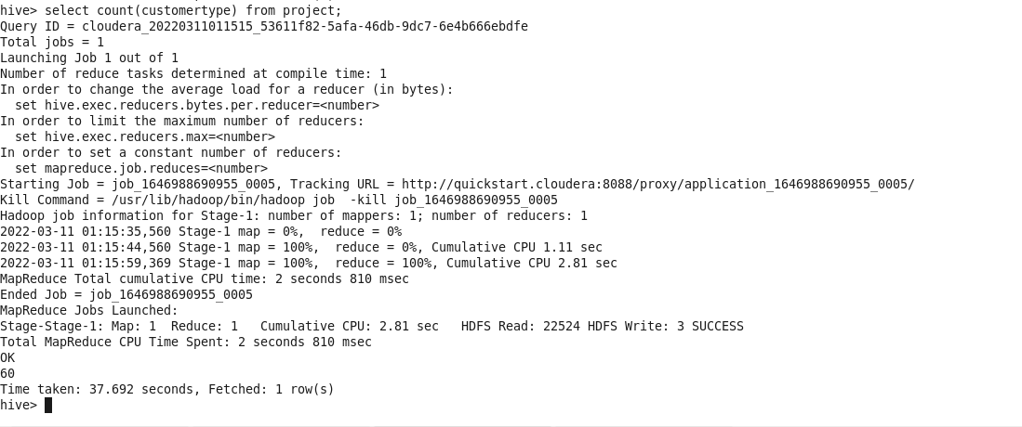
Finding different customer types: #select count( customertype) from project;

Slide 54

Printing a column in reverse order: #select reverse( invoiceid) from project;

Slide 55

To get substring from the source string. # select substr(city,3,3) from project;

Slide 56

Splitting a column values based on space between them #select split( productline,’,’)from project;

Slide 57

Capitalizing first letter of values in a column: #select initcap(payment) from project;

Slide 58

Commands used:

Slide 59


Slide 60
THANK YOU
Pamarthi pavani
Kuchimanchi Harshitha
Putti Lakshmi Mounika
Kokkari Charanraj
Kendre Ganesh

